Slide 1
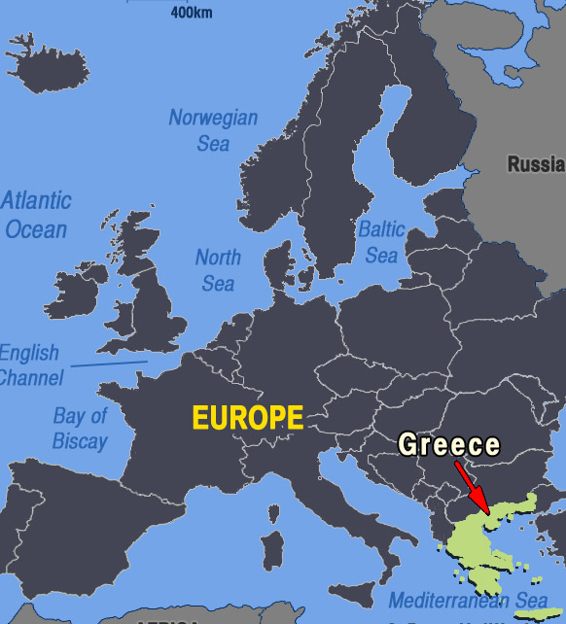
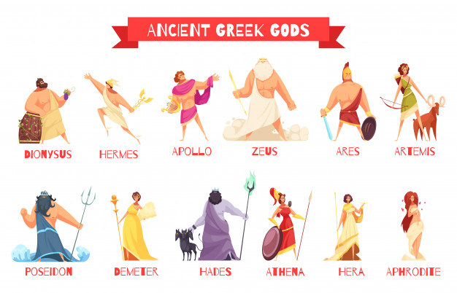
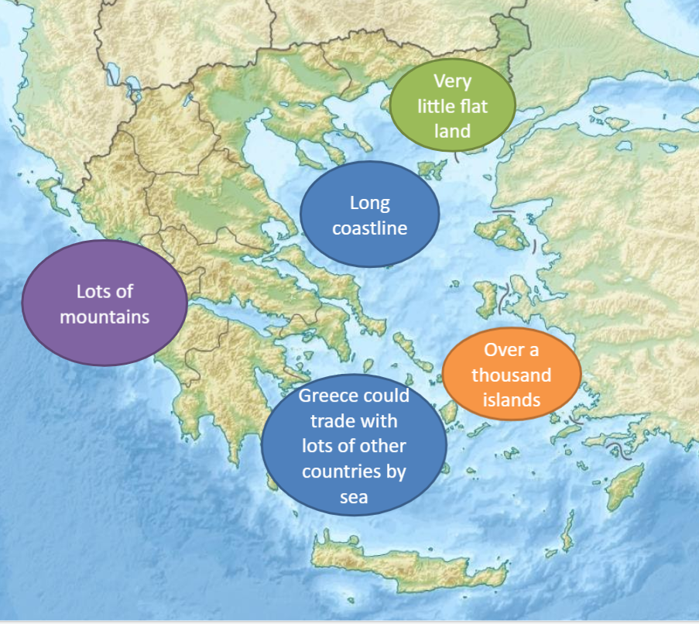
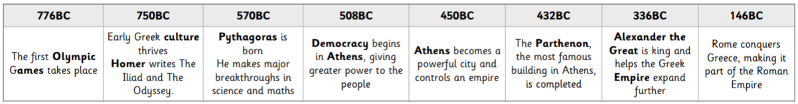
Vocabulary
Athens | The largest and most powerful city state
Sparta | A military city state surrounded by mountains to protect it from invaders
Olympics | A series of athletic challenges that takes place every four years
Democracy | When decisions are made by the majority of its people
Culture | The beliefs, customs, arts etc. of a particular society, time, place or group
City State | A city that has its own laws. Some are ruled by kings, some are a democracy, some are ruled by a small group of old men
Where is Greece?
How influential were the Ancient Greeks?
Democracy | Our own country is ruled by a government. The government is chosen by the majority of people in a general election. This is like Athens, where men are able to come together and vote on laws and policy.
Language | Over 150,000 of our words originate from Ancient Greek. This is because they passed on words to the Latin language of the Romans, and English borrows many words from Latin. Words that starts with 'ph-' are usually of Greek origin, for example: philosophy, physical, photo, phrase, philanthropy. Many English words are formed of parts of words (morphemes) that originate from the Greek language, including the following examples: phobia (fear of), as in arachnophobia – the fear of spiders micro (small), as in microscopic – so small it's hard to see demos (people) as in democracy – government by the people
Olympics | The Greeks loved sport and the Olympic Games were the biggest sporting event in the ancient calendar. Every four years, around 50,000 people came from all over the Greek world to watch and take part. The ancient games were also a religious festival, held in honour of Zeus, the king of the gods. There were no gold, silver and bronze medals. Winners were given a wreath of leaves and a hero's welcome back home.
Theatre | The theatre of Ancient Greece flourished between 550 BC and 220 BC. A festival honouring the god Dionysus was held in Athens, out of which three dramatic genres emerged: tragedy, comedy and the satyr play. Shakespeare wrote many plays of these genres, which are still enjoyed today.
Who were the Greek Gods?
There are 3 main gods, all of which are brothers: Zeus, Poseidon and Hades. Zeus is the ruler of the Gods; Poseidon is the ruler of the seas; Hades is the ruler of the underworld.

Slide 2
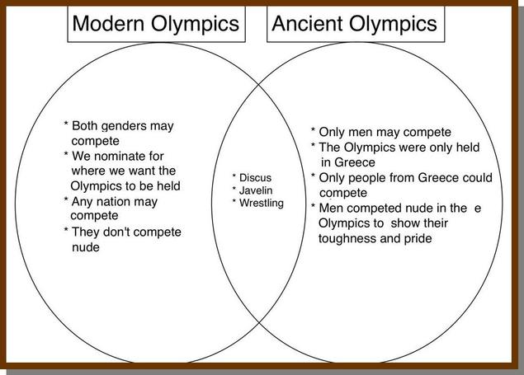
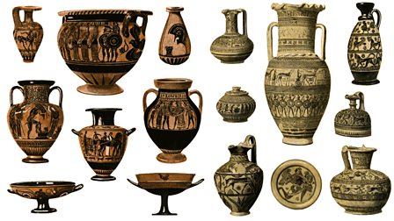
How do the modern and ancient Olympics differ?
Ancient Greece
How are Athens and Sparta different?
Athens | Sparta
A centre of art, learning and philosophy | A warrior society - including women!
Democracy | Ruled by a group of old men
Economy - Lots of trade | Economy – Agriculture (farming) and conquering
Powerful navy | Power land-army
Women had less status and freedom | Women had more status and freedom
Boys are well educated, girls are only taught chores | Boys and girls both receive training to be physically fit
Home of democracy and seen as ‘civilised’ | Dominant military
Knowledge Organiser
How do we know about Ancient Greeks?

