Slide 1
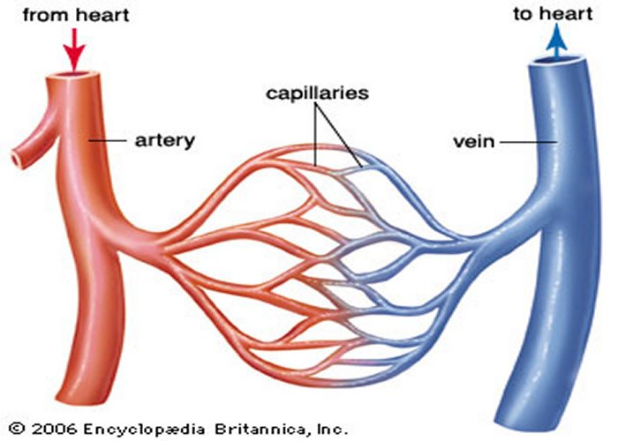
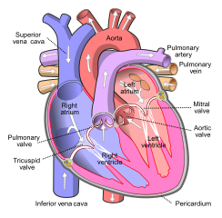
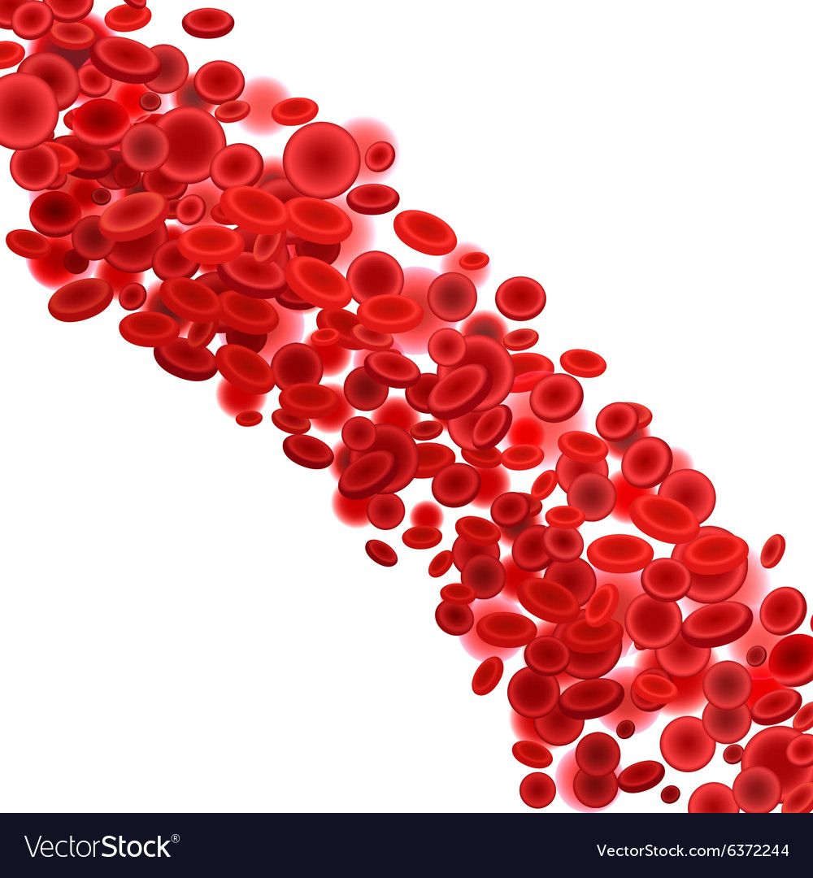
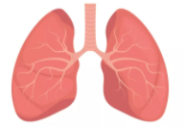
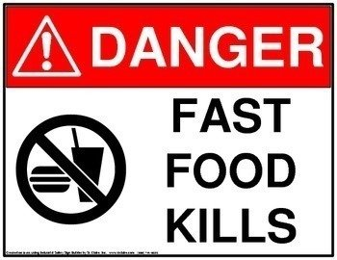
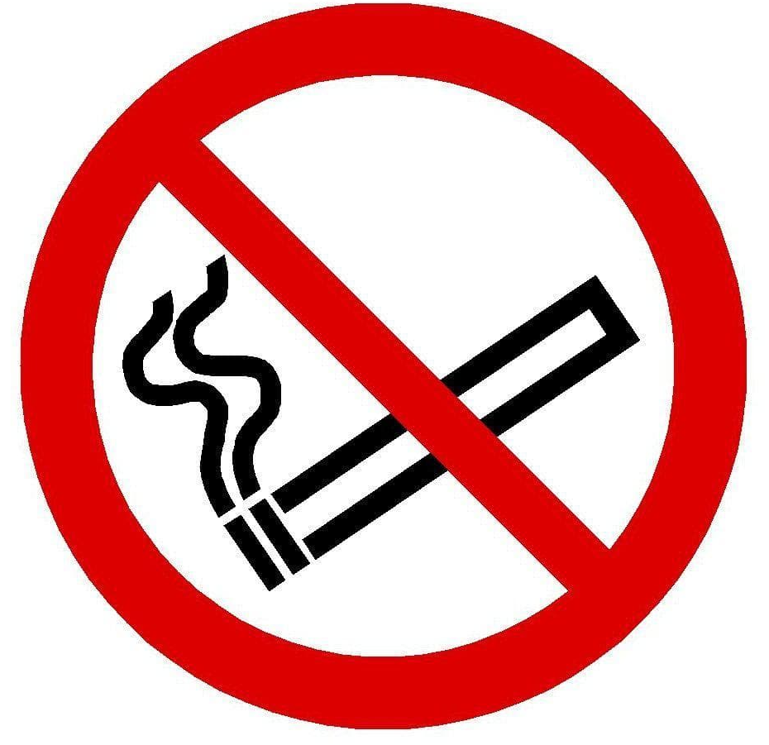
Blood vessels
There are three types of blood vessel: artery, capillary, vein. Artery – Arteries take blood away from the heart to the organs and other body tissues. Capillary – Deliver oxygen in the blood to the tissues, and pick up carbon dioxide to be eliminated Vein - Veins carry blood under low pressure from the capillaries and return the blood to the heart.
Heart
The heart’s function is to pump blood around the body. It pumps blood to the lungs, to be given oxygen; it pumps blood back to the heart; it pumps blood all around the body; it pumps blood from all around the body and back to the heart.
The Circulatory System’s 3 parts
Blood
The blood travels through a network of blood vessels (arteries, capillaries, veins) to everywhere in your body. It carries useful materials like oxygen, water and nutrients and removes waste products like carbon dioxide.
Key Vocabulary
Blood | The red liquid that circulates in the arteries and veins, carrying oxygen to and carbon dioxide from the tissues of the body
Blood vessels | Vessels (tubes) which transport blood.
Breathe | Take air into the lungs, and expel air
Carbon dioxide | Gas produced by respiration.
Circulation | Flow of blood
Circulatory | Related to the circulation of blood
Diet | The kinds of food that a person eats.
Drugs | A substance which has an effect on a person when ingested or introduced into the body
Exercise | Activity requiring physical effort
Heart | Organ that pumps blood around the body
Lungs | Organs which take in oxygen and remove carbon dioxide from the body
Nutrients | Substance that provides nourishment for the maintenance of life and growth
Oxygen | Life supporting gas needed by the body
Respire | Movement of oxygen to the body and removal of carbon dioxide
The role of the lungs
The lungs take in oxygen from the air we breathe. They also remove carbon dioxide from the body in the air we breathe out.
Health Warnings!
Fatty foods can clog arteries and prevent the heart from working effectively.
Smoking can lead to tar build up in the lungs, and can damage healthy lungs.

Slide 2
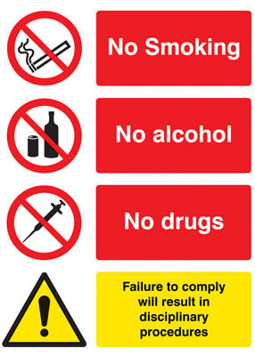
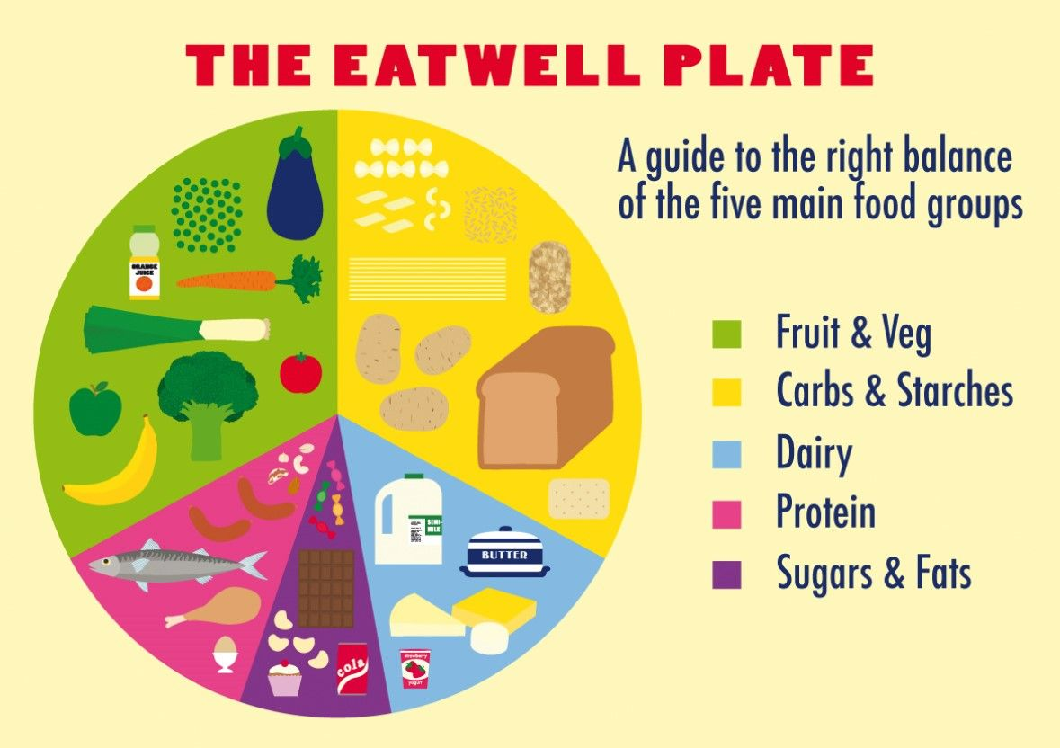
Negative impacts of drugs, alcohol and smoking:
Drugs, alcohol and smoking have negative effects on the body. Different types of drugs affect your body in different ways. You may act differently, feel differently and think differently if you have taken drugs. And you may struggle to control your actions and thoughts. Alcohol is a depressant, excessive drinking can cause an increase in anxiety, stress and depression. Smoking can cause lung disease, heart disease, strokes and is linked to cancer. All of these substances can become addictive.
Animals Including Humans - The Circulatory System
Knowledge Organiser
Benefits of exercise!
Strengthens muscles, including heart muscles. Improves circulation Increases amount of oxygen around the body Helps you sleep more easily Strengthens bones Can help to stop us from getting ill.
The importance of a healthy diet:
A healthy diet involves eating the right types of nutrients in the right amounts. Without this, you could have decreased energy and focus, and it can contribute to an unhealthy body weight. Serious, long-term effects include an increased risk of heart disease.

