Slide 1
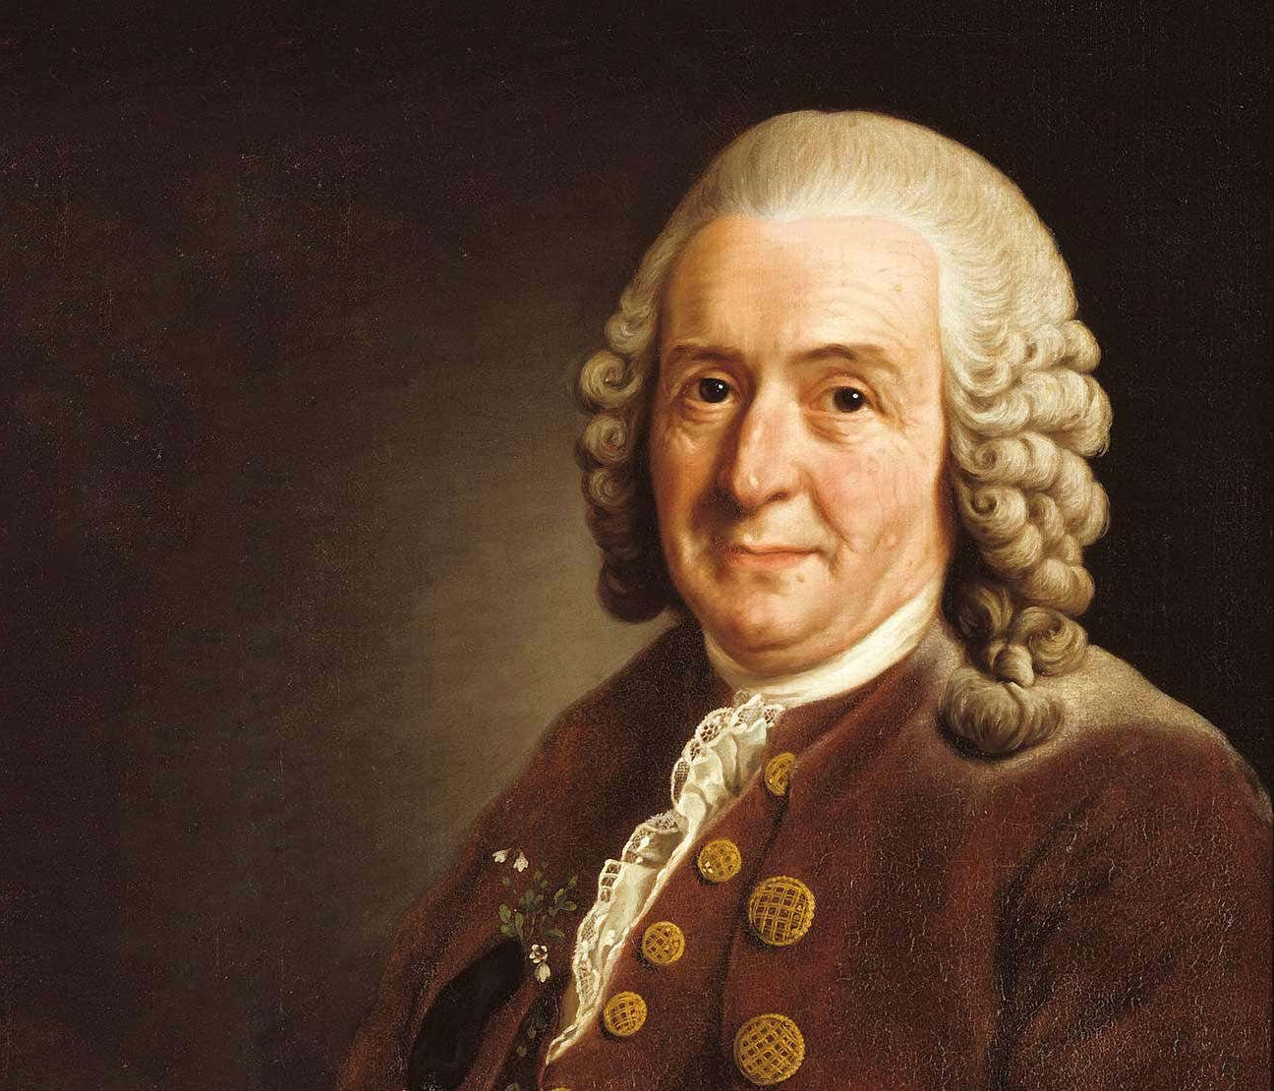
What is Classification?
Living things (including plants, animals and microorganisms) can be classified. Animals are divided into two main groups. Animals that have a backbone are called vertebrates. Animals that don't have a backbone are called invertebrates. Vertebrates and invertebrates are divided into smaller groups. Plants can be classified in their own groups.
What are microorganisms? | What are microorganisms?
Microorganisms are tiny living things. These can be divided into groups | Microorganisms are tiny living things. These can be divided into groups
Bacteria | Fungi
Note: Viruses are not generally considered by scientists to be living things, so are not included in this category.
Vertebrate Groups
Fish | Amphibians | Reptiles | Birds | Mammals
Invertebrate Groups
Insects | Arachnids | Crustaceans | Molluscs
Plant Groups
Mosses | Ferns | Conifers | Flowering Plants
How are living things classified into these groups?
Living things are classified into broad groups according to common observable characteristics and based on similarities and differences, including micro-organisms, plants and animals. For example: all the animals in the ‘birds’ group have feathers.
Why do we classify?
When you see an organism that you have never seen before, you probably group it with other, similar organisms without even thinking about it. You would probably classify it on the basis of obvious physical characteristics. For example, if an organism is green and has leaves, no doubt you would classify it as a plant. Scientists also group together similar organisms. The science of classifying living things is called taxonomy. Scientists classify living things in order to organise and make sense of the incredible diversity of life. They group together organisms that have similar characteristics and also that have similar DNA.
Who is Carl Linnaeus?
Carl Linnaeus is famous for his work in taxonomy, the science of identifying, naming and classifying organisms.

Slide 2
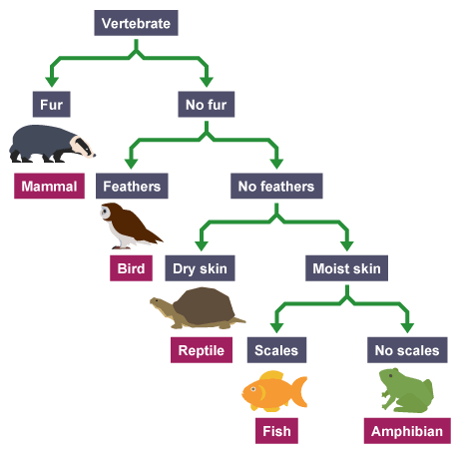
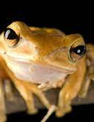
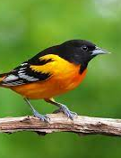
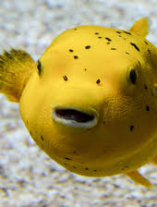
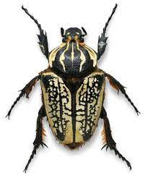
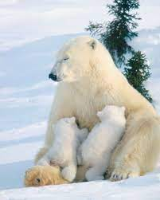
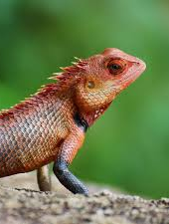
Key Vocabulary
Amphibian | Have lungs, backbone, cold-blooded, slimy wet skin, can live in water and on land
Bird | Warm-blooded, feathers, beaks, lay eggs, have a backbone
Characteristic | The distinguishing features or qualities that are specific to a species
Classification key | A classification key is a series of questions that determine an organism's physical characteristics
Classify | Arrange and order according to shared characteristics
Difference | Something that is not the same, not similar.
Fish | Have fins, a backbone, cold-blooded, use gills to breathe
Flowering | Plants that have flowers
Group | A number of things classed together
Insect | Six legs, no backbone, three body parts
Invertebrate | Animals without backbones
Mammal | Have lungs, a backbone, warm-blooded, live babies (do not lay eggs)
Micro-organism | Tiny living things, such as a bacteria and fungus. Microscopic in size.
Non-flowering | Plants that have no flowers
Reptile | Scaly skin, backbone, cold-blooded, live on land, have lungs, lay eggs
Similarity | When there is something alike.
Vertebrate | Animals with backbones
Classification Key
Classification
Knowledge
Organiser

