Slide 1
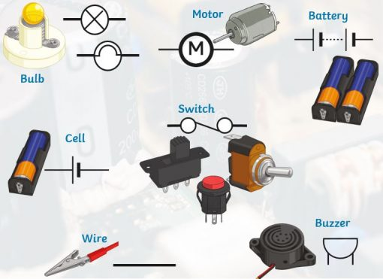
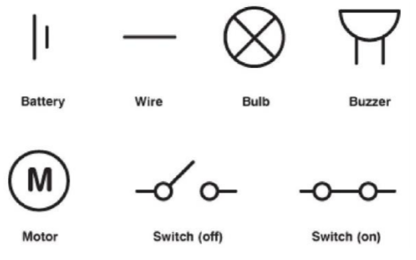
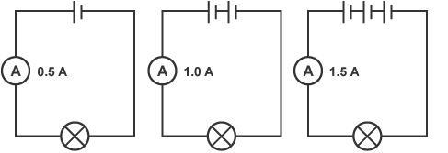
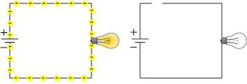
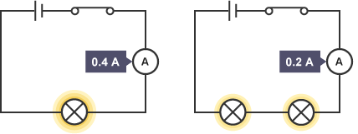
What will make a bulb brighter or a buzzer louder?
• More batteries or a higher voltage create more power to flow through the circuit. This makes bulbs brighter and buzzers louder. • Shortening the wires means the electrons have less resistance to flow through.
Circuit Symbols
Insulators | Conductors
Some materials do not allow electricity to pass through them. These are insulators. Plastic, wood, glass and rubber are good electrical insulators. That is why they are used to cover materials that carry electricity. Plastic covering that surrounds wires is an electrical insulator. It stops you from getting an electrical shock. | Some materials let electricity pass through them easily. These materials are known as electrical conductors. Many metals, such as copper, iron and steel, are good electrical conductors. That is why the parts of electrical objects that need to let electricity pass through are always made of metal.
What will make a bulb dimmer or a buzzer quieter?
• Fewer batteries or a lower voltage give less power to the circuit. • More buzzers or bulbs mean the power is shared by more components. • Lengthening the wires means the electrons have to travel through more resistance.
Open and closed circuits
An open circuit is one where the components and wires in a circuit are not complete and all joined (right). A closed circuit is one that is complete, with good continuity throughout. A closed circuit is needed for components to work and for electricity to flow through the circuit.
Important scientists Alessandro Volta – Italian physicist who is credited with inventing the battery Edith Clarke – American scientist who was the first woman to be professionally employed as an electrical engineer in the United States | STEM Career Links Electrical Engineer (works with equipment that uses electricity) Electrician (installs and maintains electrical equipment) Renewable Energy Engineer (works on environmentally conscious) | Links to real life What if we didn’t have electricity? Why do we have power cuts? How do fuses work? Our mobile phones have a battery, but we have to plug them in too; why?

Slide 2
What is Electricity?
Electricity is the flow of electrical power or charge. Electricity is created by generators which can be powered by gas, coal, oil, water, wind or solar. The electrical energy can be converted into other types of energy such as light, heat, movement or sound. Electricity is dangerous, so be careful when using electrical appliances.
Key Vocabulary
Battery | A device that stores energy as a chemical until it is needed. A battery is a collection of cells.
Bulb | A glass lamp that provides light by passing an electrical current through a filament.
Buzzer | An electrical device that makes a buzzing noise used for signalling.
Cell | A device that stores energy as a chemical until it is needed. A cell is a single unit.
Circuit | A path that an electrical current can flow around.
Circuit diagram | A circuit diagram is a simple image of the components of an electrical circuit.
Circuit symbol | A visual picture that stands for the actual object.
Complete circuit | A complete and closed path that a circulating electrical current can flow through.
Lamp | A device for giving light, consisting of an electric bulb together with its holder
Motor | A machine powered by electricity that will enable a device to move.
Switch | A device for making or breaking the connection in a circuit.
Voltage | An electrical force that makes electricity move through a wire, measured in volts.
E l e c t r i c i t y
Knowledge Organiser

