Slide 1
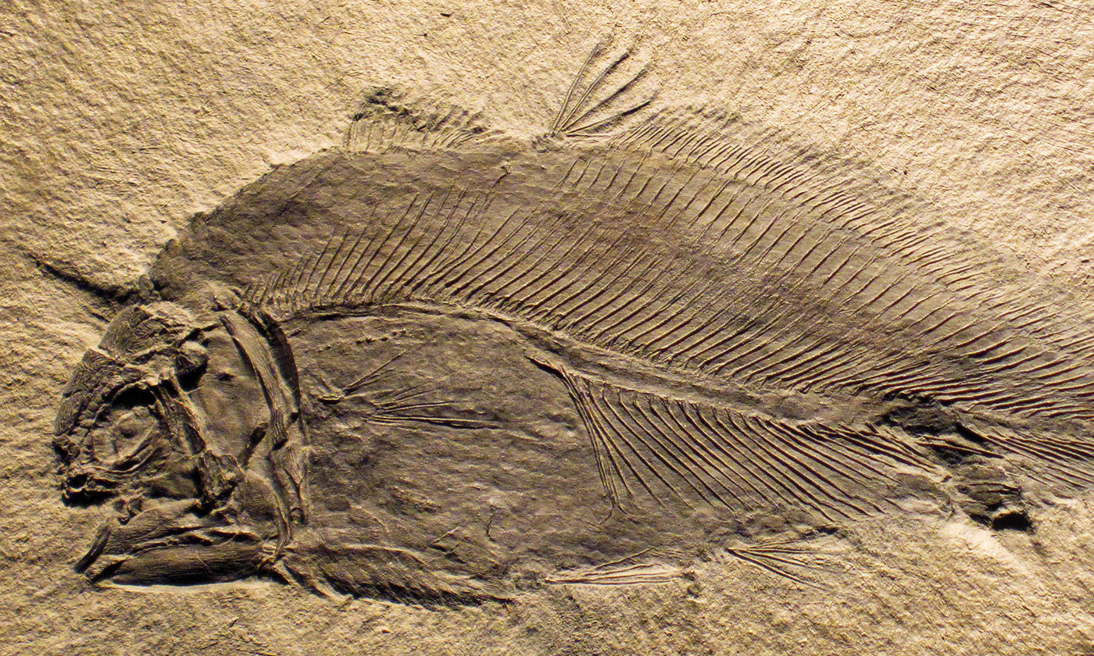
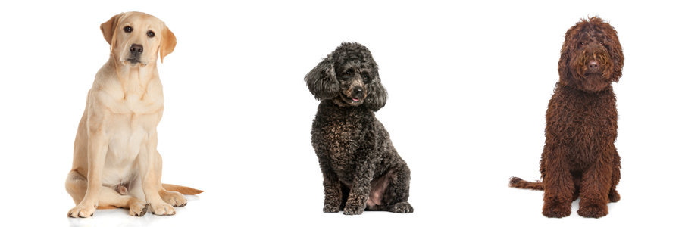
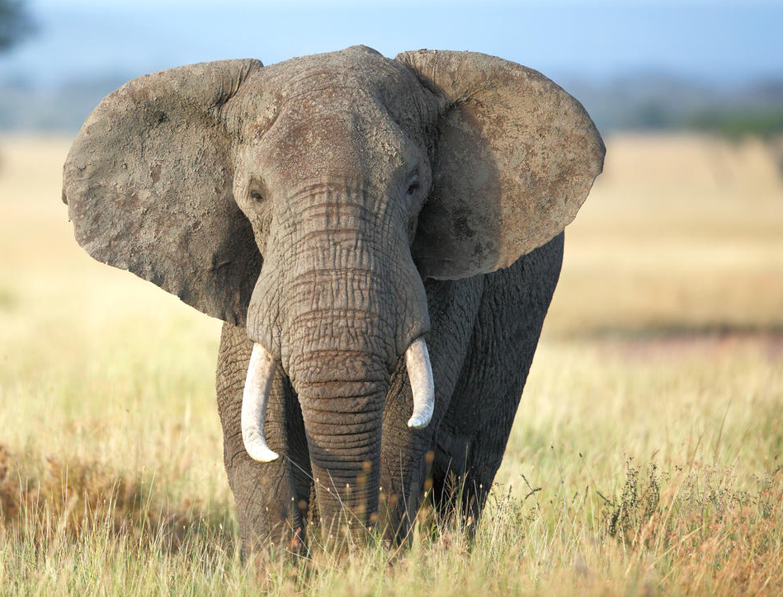
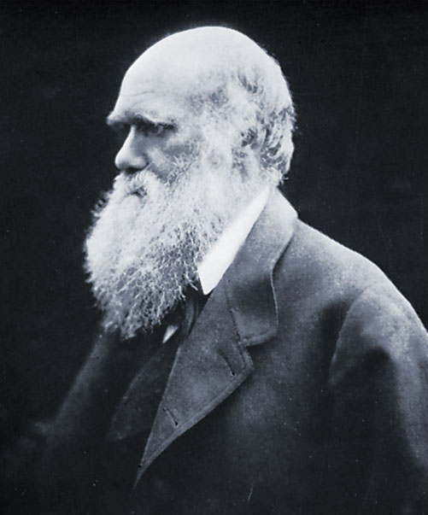
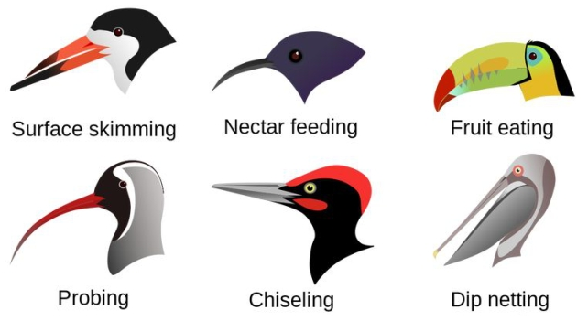
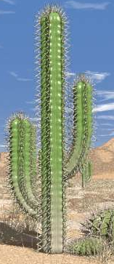
What is a fossil?
A fossil is the preserved remains or traces of a dead organism. The process by which a fossil is formed is called fossilisation. After an animal dies, the soft parts of its body decompose leaving the hard parts, like the skeleton, behind. This becomes buried by small particles of rock called sediment. Fossils can teach us about animals that lived in the past and changes to the earth. For example, rocks that once formed the seafloor might be forced up to form a mountain range. This means that you can sometimes find the fossils of sea creatures at the peak of a mountain.
Charles Darwin
Charles Darwin came up with the theory of evolution - he published it in a book called ‘The Origin of the Species’ in 1859. The theory states that animals adapt over time- the most successfully adapted animals are the ones which survive and procreate. This leads to changes in animal species over time (evolution).
What is inheritance?
When living things reproduce they pass on characteristics to their offspring. This is known as inheritance. This is why children often look like their parents, or why a mix of two dog breeds will produce offspring which has some characteristics from each parent. Even when the breed is the same, offspring vary and are not identical to their parents, but have some characteristics.
Adaptation means how living things are specialised to suit their environment. An African elephant, for example, lives in a hot habitat and has very large ears that it flaps to keep cool.
Adaptation
Animals have to adapt, change, over many years to suit their environment. Look at these birds and how their beaks have needed to change to suit their environments.
Plants also need to adapt to their environment. A cactus has adapted to be able to store water and has a waxy covering to prevent it from drying out. They also have long roots, spread more widely to reach water from further away.

Slide 2
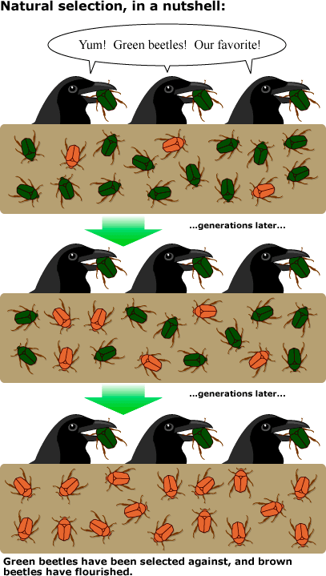
Evolution
and Inheritance
Natural Selection
Individuals in populations vary slightly from one another. The orange variation helps, as the birds eat the green. Offspring that inherit the orange colour continue to live and produce more offspring. As generations pass, the population evolves towards the variation that is the more successful.
Knowledge Organiser
Key vocabulary
Adapt | Change a trait to better be able to survive and reproduce.
Adaptation | A trait changing to increase a living thing’s chances of survival.
Characteristic | The distinguishing features or qualities that are specific to a species.
Difference | Something that is not the same, not similar.
Environment | An environment contains many habitats.
Evolution | Adaptation over a very long time.
Evolve | To change and adapt over a long period of time.
Fossil | Remains or imprint of an animal embedded in rock and preserved.
Habitat | A specific area or place in which particular animals and plants can live.
Identical | Similar in every detail, exactly alike.
Inheritance | Giving a trait from a parent to its offspring.
Offspring | The young animal or plant that is produced by parents
Parent | An animal or plant that produces offspring.
Similarity | When there is something alike.
Variation | The difference between individuals of the same species.

