Slide 1
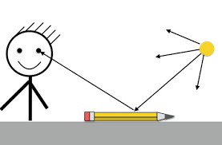
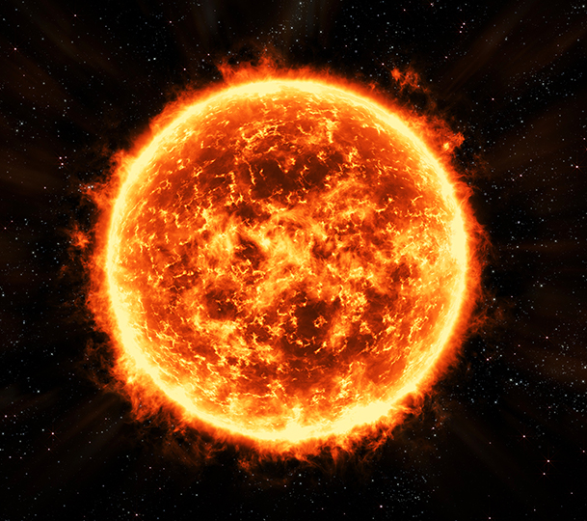
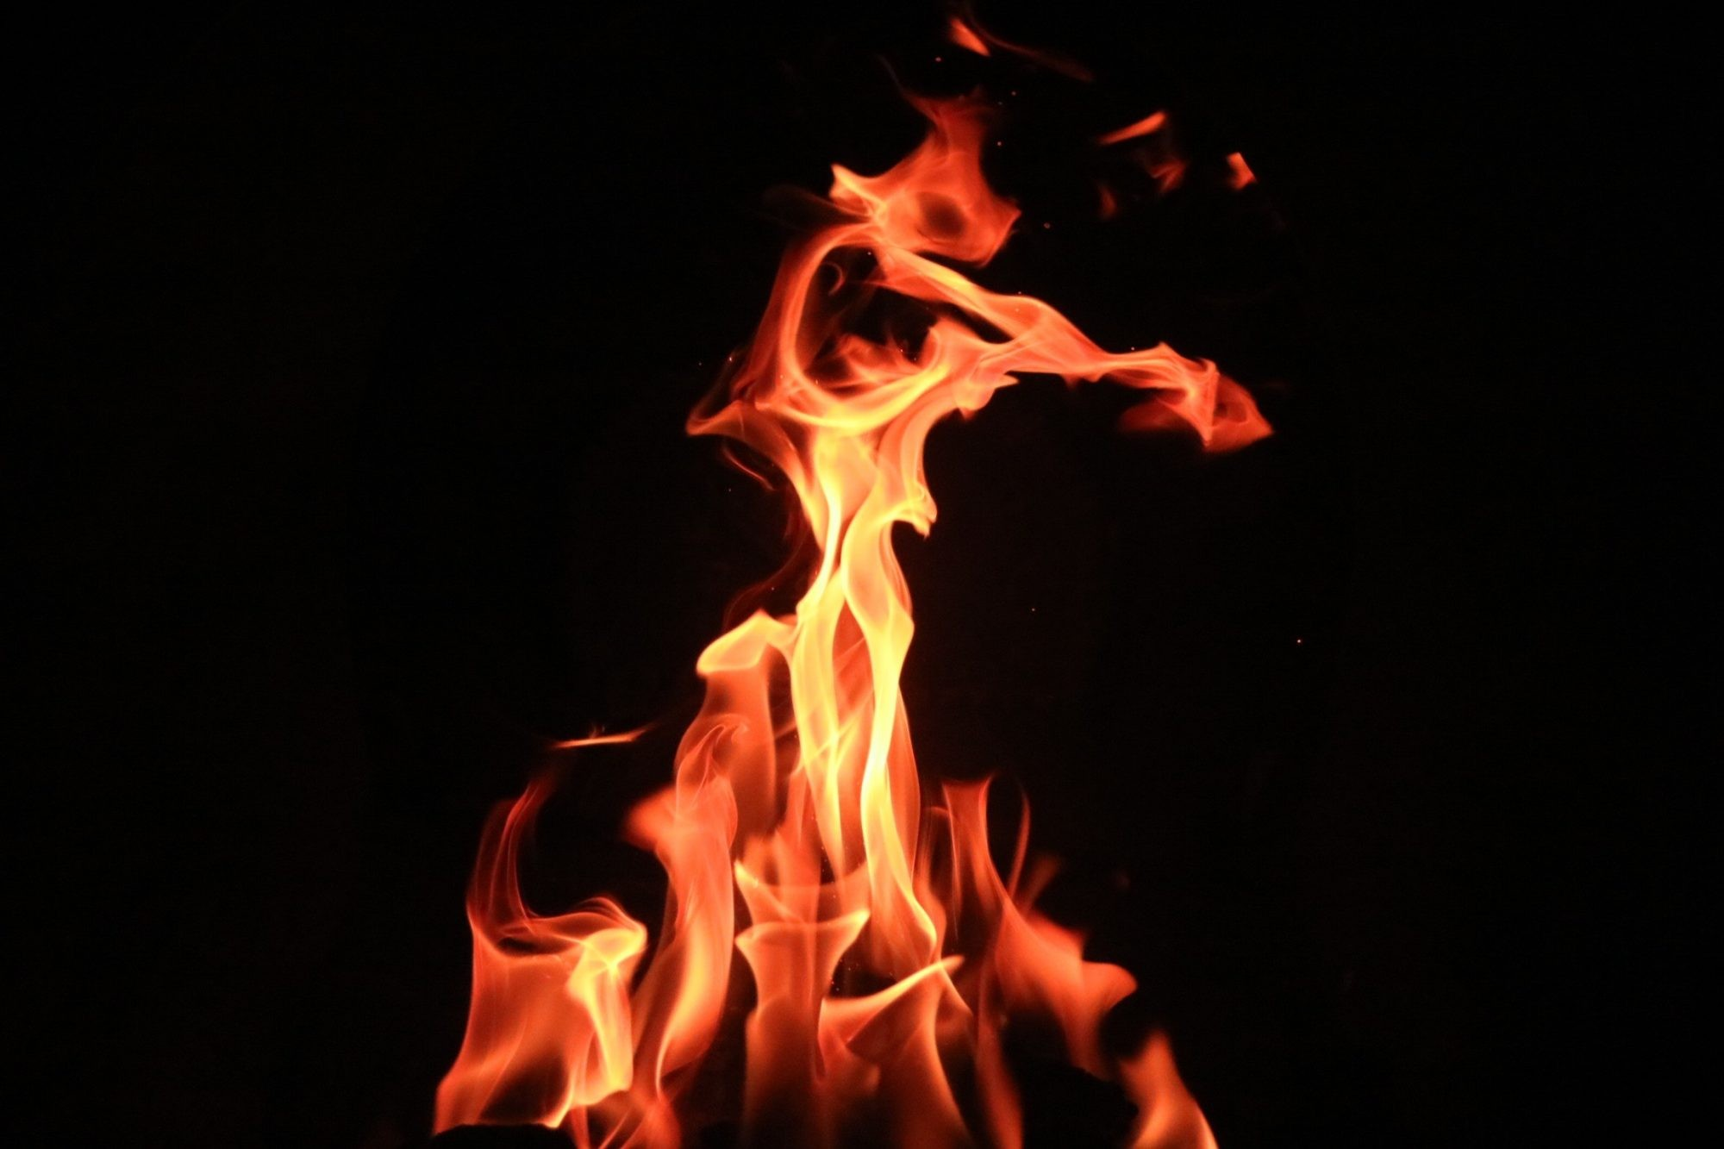
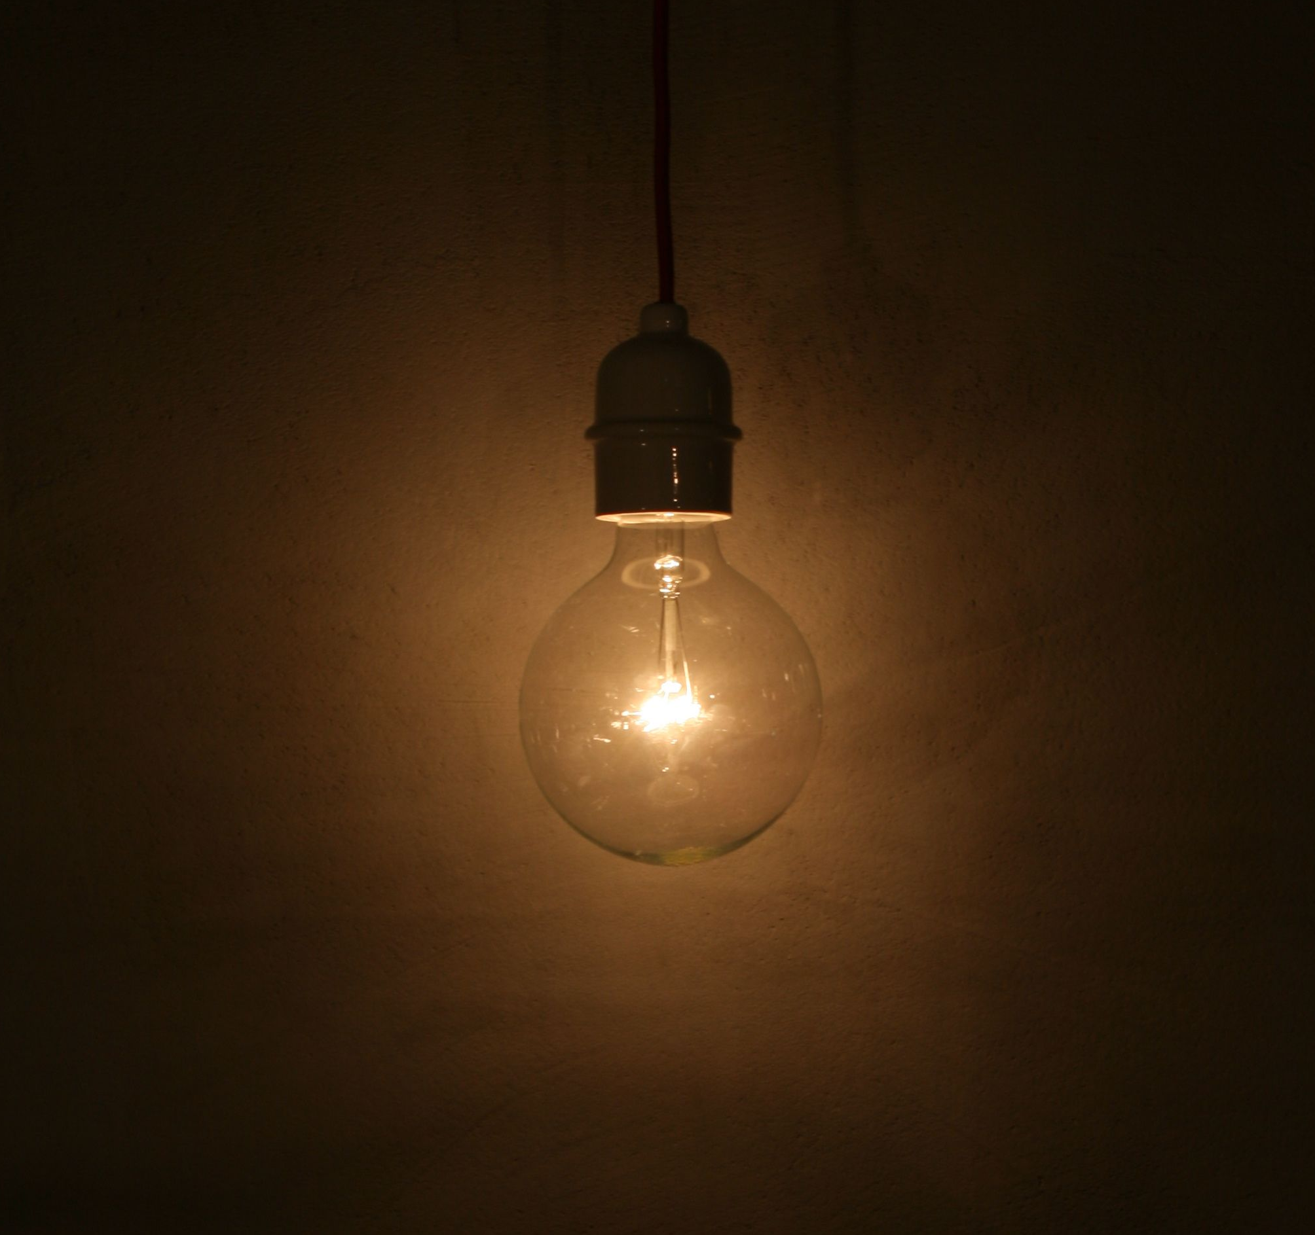
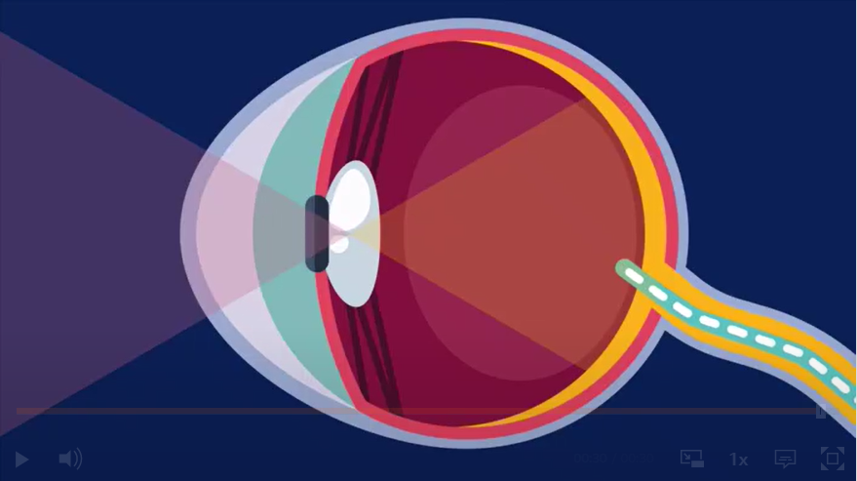
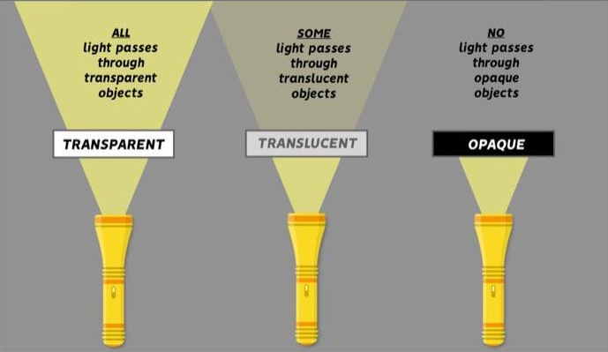
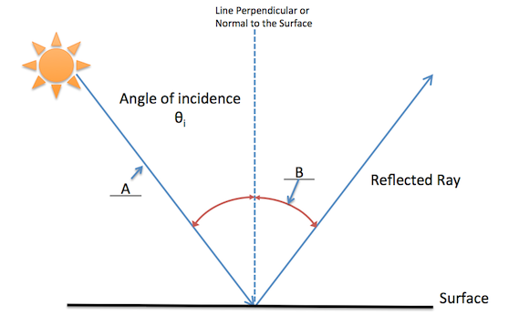
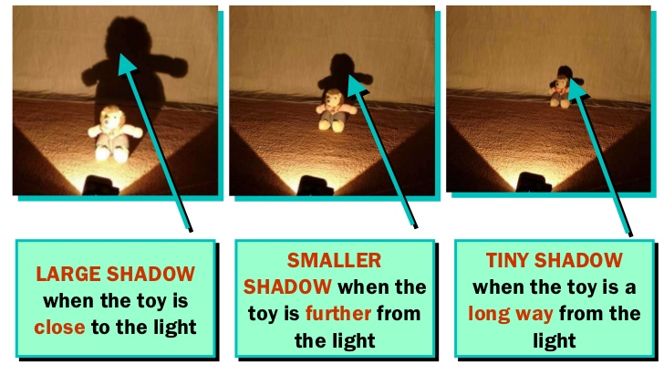
Light sources
A source of light makes light. The Sun and other stars, fires, torches and lamps all make their own light and so are examples of sources of light. Some animals, such as fireflies and glow-worms, are light sources. They make their own light to attract mates.
How do we see?
When light enters our eye, it sends a signal to the brain, which creates the image. This is what we call seeing. Light from a light source enters our eye Light from a light source hits an object, the light is reflected and enters our eyes.
Reflection
When light from an object is reflected by a surface, it changes direction. It bounces off the surface at the same angle as it hits it. Smooth, shiny surfaces such as mirrors and polished metals reflect light well. Dull and dark surfaces such as dark fabrics do not reflect light well.
Key Vocabulary
Eye | Organ that is responsible for allowing us to ‘see’ by taking in light.
Light | A form of energy that makes vision possible
Light source | An object that produces its own light
Ray of light | A single straight beam of light
Reflection | When a light hits a surface and ‘bounces’ off
Shadow | A dark area or shape caused by the blockage of light
Objects can be labelled as transparent, translucent or opaque, depending on the amount of light they let through.
A ray of light hits a surface and reflects at the same angle.
What are shadows?
Shadows are formed when light cannot pass through an object, the object must be opaque. Shadows are formed in the same shape of the object casting them. Your hands are a great example, as you can make your own shadow puppets! The size of a shadow increases as it moves closer to the light source.

Slide 2
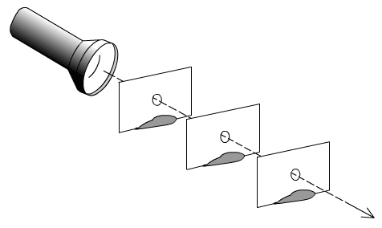
How does light travel?
Light travels in straight lines. Once light has been produced, it will keep travelling in a straight line until it hits something else. This experiment shows this. How can light be seen through all the index cards? The holes are in alignment and the light travels in a straight line. What does the experiment prove about the path light travels? Light travels in a straight line. What would happen if the holes were smaller? The light would continue to travel in a straight line but in a more restricted path.
L i g h t
Knowledge Organiser
Important scientists Thomas Edison – American business man who is credited with inventing the light bulb Ibn Al-Haytham – Iraqi scientist who made important contributions to the understanding of vision, optics and light Percy Shaw – English inventor who invented ‘cats eyes’ for roads. | STEM Career Links Astronomer (studies space) Ophthalmologist (a doctor specialising in vision and eye health) Optician (a doctor specialising in vision and eye health) | Links to real life How can lights help to keep us safe? When are highly-reflective materials useful to our lives? Why are mirrors used in cars and on bends in country lanes? How do we create a dark space when we go to bed in summertime and it’s still light outside?

