Slide 1
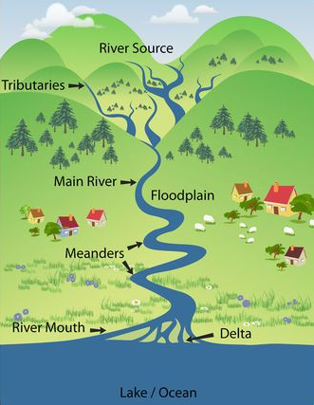
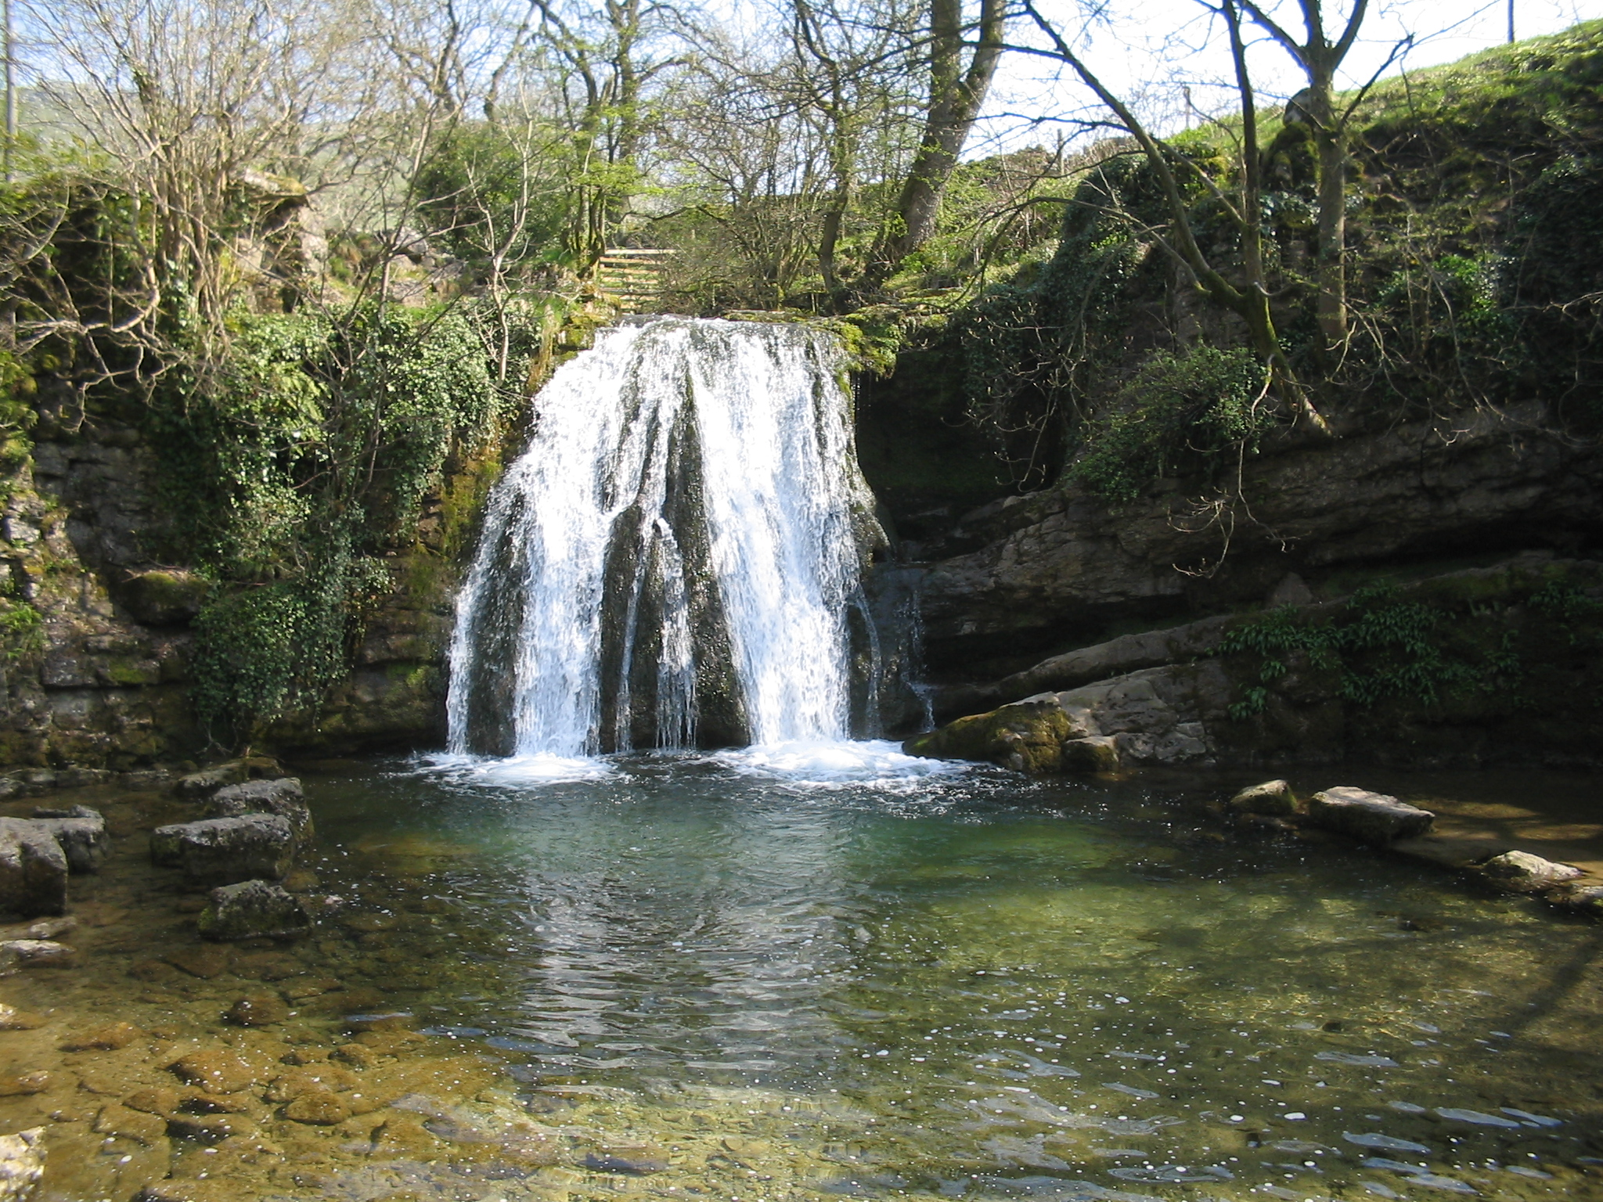
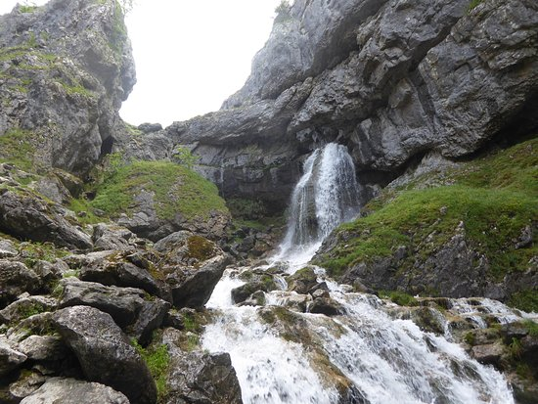
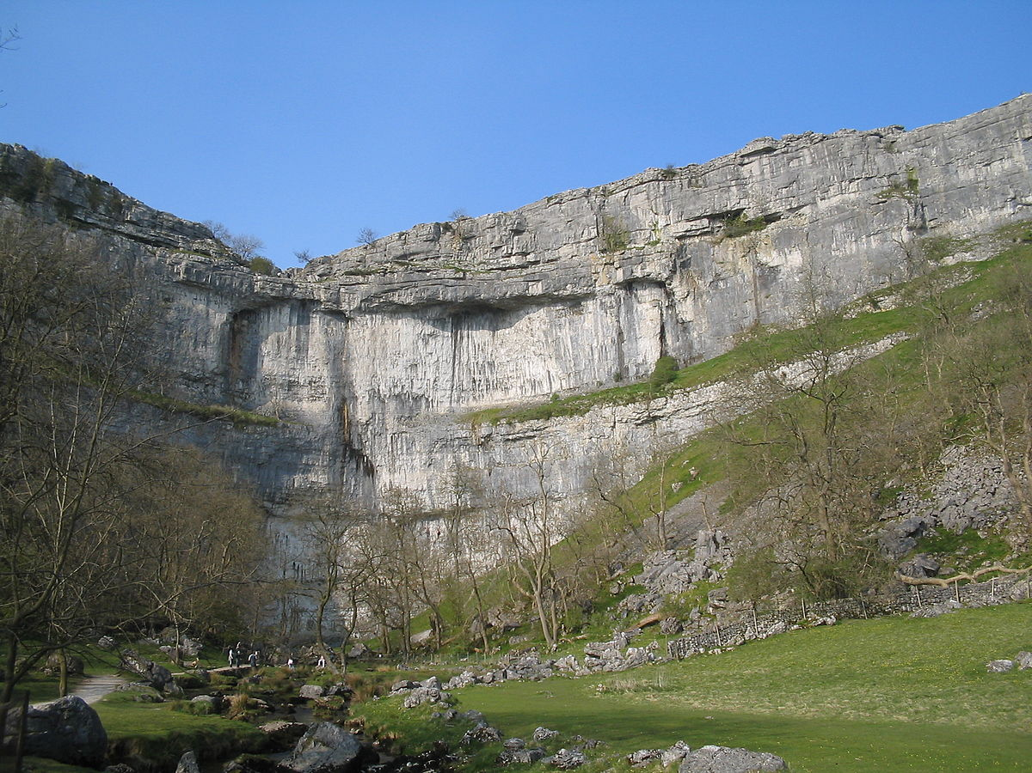
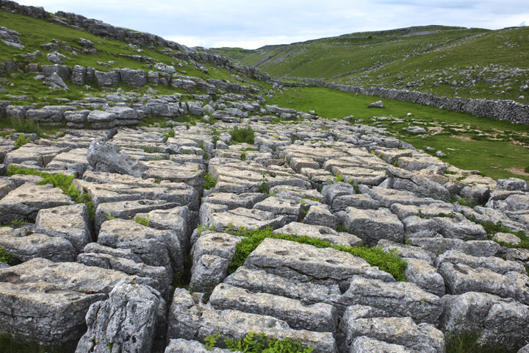
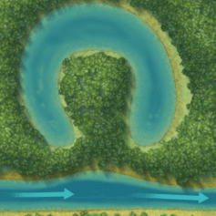
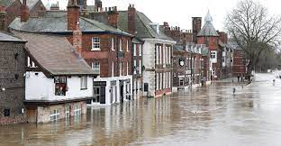
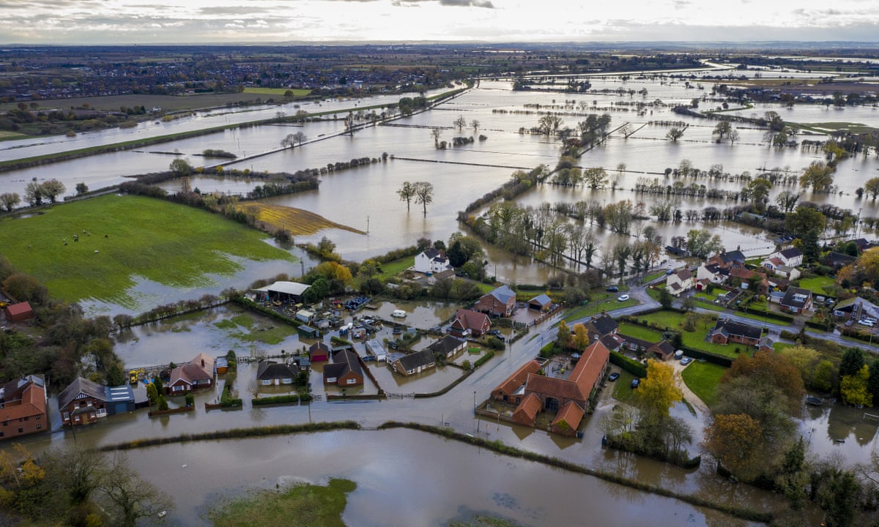
Features of a river and its journey
A river starts at a source- usually high up and faster flowing- upper course. Here the river carries stones and sand from the riverbed. The middle course of the river is wider and deeper, with slower moving water. Here the river can deposit stones and sand, causing changes to the land formation. The lower course is where the river feeds into another river or the sea. The mouth of the river is where it flows into the sea.
Janet’s Foss, waterfall, Malham
Gorge at Gordale Scar, Malham
Key Vocabulary
Bank | The land at the side of the river
Current | The movement of the water, its flow
Deposit | Material that is left, deposited, dropped off to somewhere
Erosion | The break down, wearing away of something – here it is the break down of rocks and soil into smaller pieces which can be carried along the river
Floodplain | A low area next to a river, which is subject to flooding
Meander | A winding curve/bend in a river
Mouth | Where the river opens out into the lake/sea/ocean
Ox-bow lake | A curved lake forming a horseshoe shape where a river no longer flows through, an unused meander
River bed | The ground over which a river flows
Sediment | Deposits that settle at the bottom of the river
Source | The start of a river, where it begins
Tributary | A smaller river that leads into a bigger river
Malham cove, Malham
Limestone pavements, Malham
How can weather affect the land?
Flooding: There are several factors that can cause floods. River flooding usually happens when there has been a great deal of rainfall higher up in the river course which then travels down and overflows the riverbanks. In higher or colder regions, melting snow or ice have the same affect and cause the river level to rise above its banks and flood.
How does a river form?
Rivers usually begin in upland areas, hills or mountains, when rain (or another form of precipitation) falls on high ground and begins to flow downhill. They always flow downhill because of gravity. The water erodes, wears away, land and creates a pathway for the water to follow – this continues until the river joins another body of water - this could be another river, a lake, the sea or ocean..

Slide 2
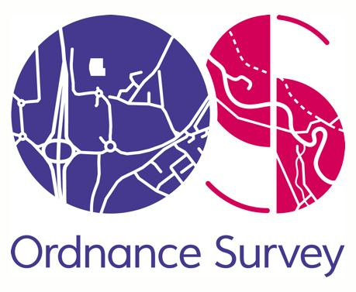
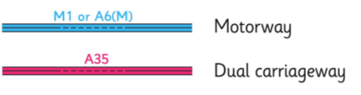
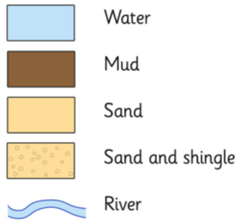


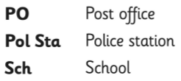




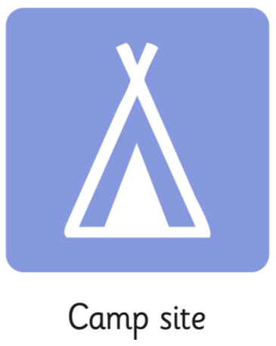
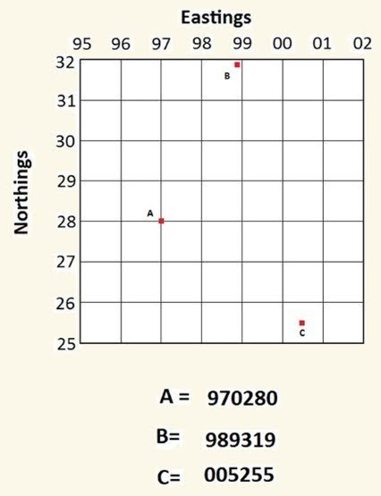
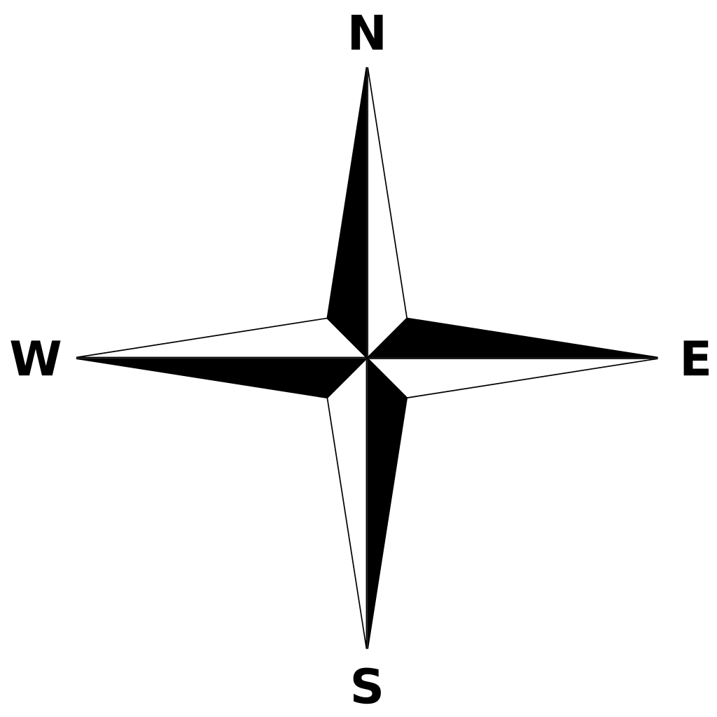
Do your know your OS symbols?
R i v e r s
Knowledge Organiser
You need to know your compass directions!
There are 4 figure gird references:
A = 9728
And also 6 figure:
A = 970280
Imagine that between 97 and 98 there are 10 jumps. This is how you get the reference 970

