Slide 1
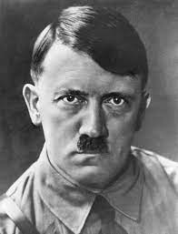
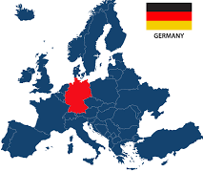
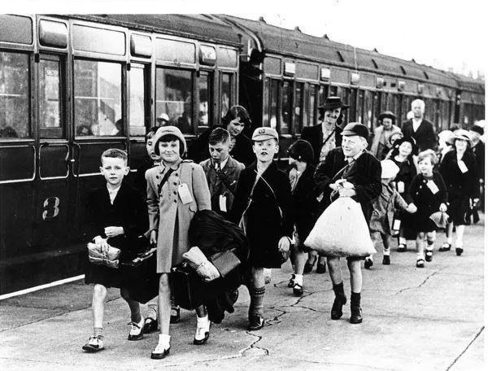
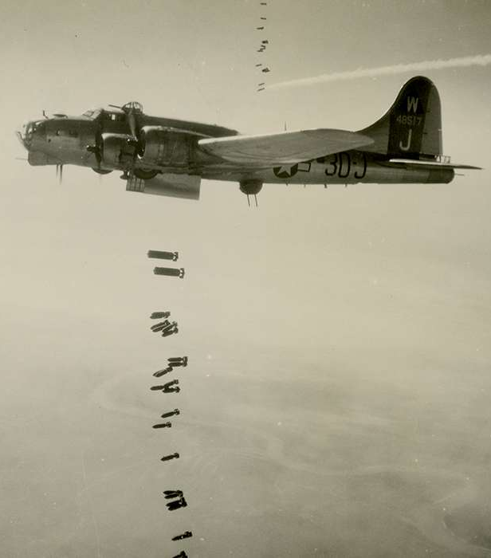
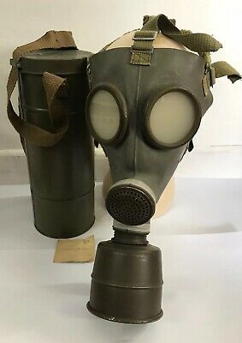
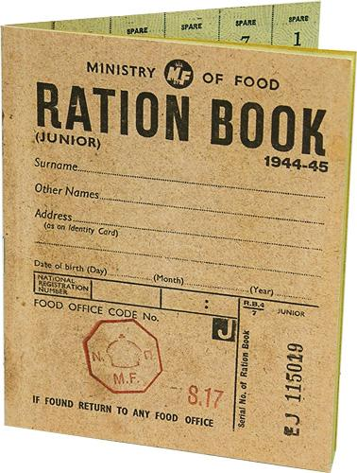

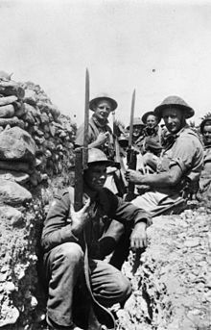
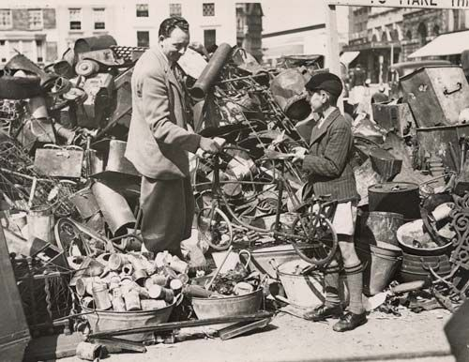
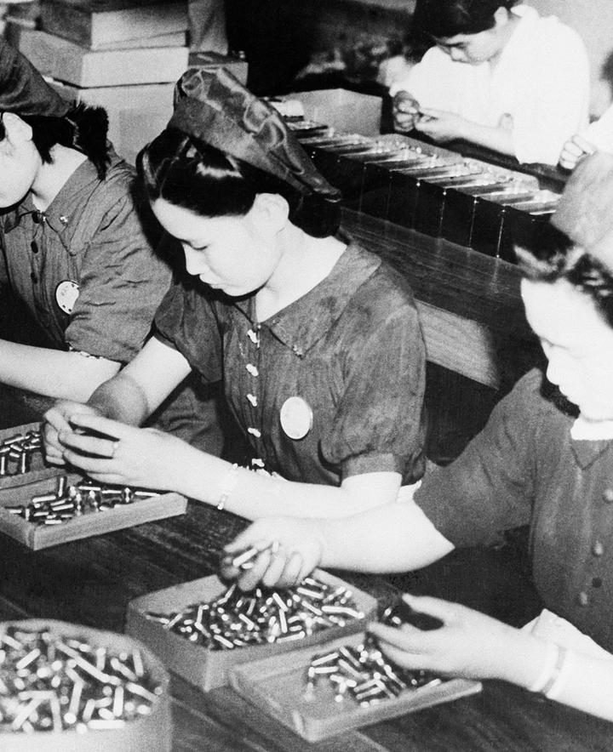
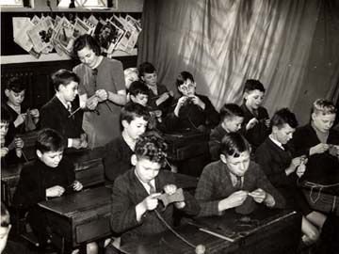
How did WW2 begin?
WW2 started in 1939 and it ended in 1945. Britain went to war with Germany, as Hitler tried to invade Poland after he promised not to.
How did life change during wartime?
Evacuation Many of those who stayed, endured bombing raids and were injured or made homeless. Bomb shelters had to be constructed to keep people safe. All had to deal with the threat of gas attack and air raids. People would have to carry gas masks with them. Every man, woman and child was given a ration book with coupons. These were required before rationed goods could be purchased. Basic foodstuffs such as sugar, meat, fats, bacon and cheese were directly rationed by an allowance of coupons.
Top left – Adolf Hitler, leader of Germany
Bottom left – Swastika, the flag for the Nazi party
Above - Germany
Julie
16th July
01284771307
What were the roles of men and women during the war?
Men | Women
Many men were conscripted into the armed forces. All healthy men aged between 18 and 41 were required to become soldiers, unless they were doing certain jobs, such as mining or farming .T hese men had to stay at home, as food production and mining of resources was still key during the war effort. By the end of World War over 100,000 men from Leeds had joined the war. | More women started to work as a result of the war- by 1943, 90% of all single women were employed. Women took on a whole range of new roles. Women worked in factories producing munitions, building ships, aeroplanes, in the auxiliary services as air-raid wardens, fire officers and evacuation officers, as drivers of fire engines, trains and trams, as conductors and as nurses!
What was it like being a child during ww2?
Children were evacuated out of cities to prevent them being harmed during air raids. They were often sent to stay with other families. In 1939 18,250 children along with 1450 teachers travelled to new homes in the countryside. For those children who stayed at home, they would have to help with farming. Children were encouraged to recycle – recycling and repairing clothes and salvaging items (mostly metal) for making aircraft. Top left – photo of boy salvaging and collecting metal Bottom left – boys sewing and repairing clothes to be reused and worn. Girls would also help!

Slide 2
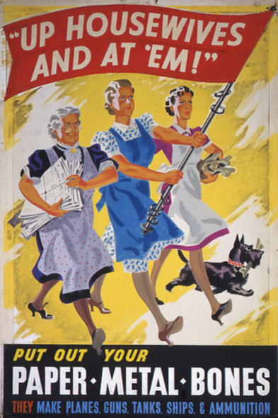
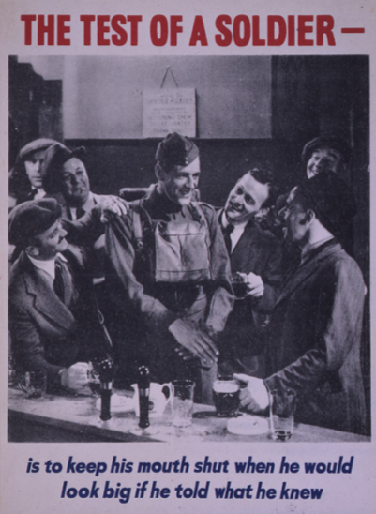
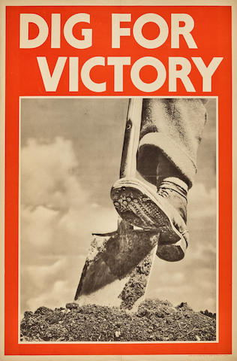
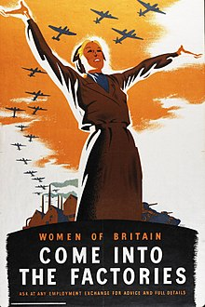
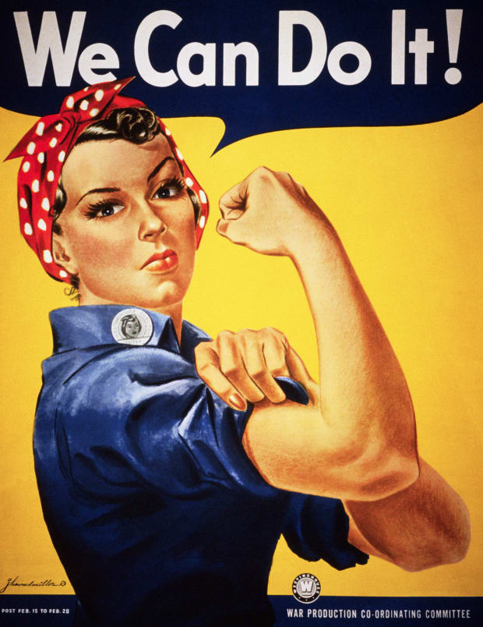
How were people persuaded to help the war effort?
The government issued many poster rallying people to support the war effort. This included women taking on roles left by men, people growing their own food, women working!
WW2
Knowledge Organiser
Key vocabulary
Blackout | A time when all lights are turned off to cover a place being seen during an air raid
Blitz | A series of bombing raids on the UK
Censorship | Controlling what newspapers can publish.
Conscription | You are forced to join the army
Evacuation | Where people are moved from towns and cities to safe zones
Luftwaffe | The German air force
Nazi | The political party led by Hitler, a follower of Hitler is called a Nazi too
Propaganda | Controlling news media to show your side in the best way
Ration | When something is limited, you are only allowed so much of it. German submarines prevented food from being delivered to Britain, so supplies were low. As a result, food was rationed from 1940 to 1952.

